Slide 1

Pet Retention at Denver Animal Protection
Louisa Poon DVM PhD CCRP

Slide 2
Who are we?
Denver Animal Protection aka Denver Animal Shelter
Open admission, municipal shelter of City and County of Denver
Annual admission ~6500
~6200 dogs and cats
~75% dogs
~25% cats
Owner relinquished/surrendered
Stray
Administrative hold
Confiscate
Quarantine

Slide 3
Evolution of Shelter Medicine
Initially-how to take care of shelter owned animals
Infectious disease control
Enrichment/5 Freedoms
Decreasing stray population-s/n sx
Shift in focus concentrating on length of stay (LOS)
Adoption/Transfer
RTO
Euth
Now the hot topic is: Pet retention = stopping/decreasing intake

Slide 4
ASPCA Position Statement
“believes that pets and people belong together”
“financial circumstances alone are not reliable indicators of the capacity to love and care for a companion animal”
“strong bonds between people and pets make for stronger communities”
Strong position statement & focus on pet retention
“Pet Retention” grants available

Slide 5
$$$
ASPCA Pet Retention Grant
As part of the grant application, survey on owners using the ASPCA questionnaire
# of dogs & cats relinquished by owners:
~530 in 2016
21 owners surveyed using the ASPCA questionnaire

Slide 6
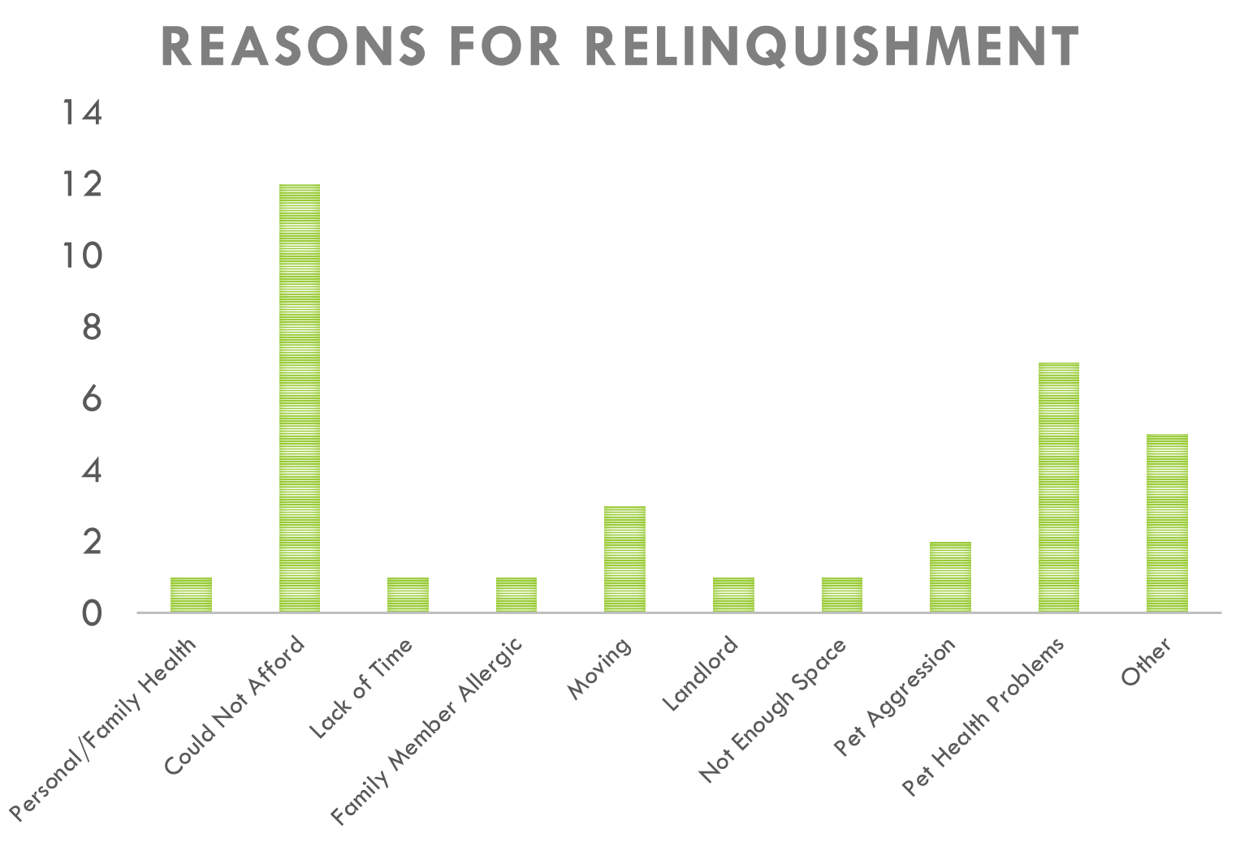
Results from ASPCA Questionnaire

Slide 7
ASPCA Pet Retention Grant
DAP awarded $50,000 from ASPCA
DAP committing further $25,000 to this project
one-year pilot program (2017)
Target: 40 dogs and 20 cats

Slide 8
Pet Retention Program Proposal
ASPCA Award: |  | $50,000
Denver Animal Protection commitment: |  | $25,000
 |  |  | covered by
 |  |  | ASPCA | Denver Animal Protection
Medical Care and Treatments |  | $40,000 | $35,000 | $5,000
 | Medications: including flea/tick, ear and skin infections, and URI
 | Diagnostics: including x-rays and blood tests
 | Other vet care: including tumor removal and repairing broken bones
Pet Retention Supplies |  | $12,500 | $10,000 | $2,500
 | Pet food and pet products: including litter, leashes, ID tags, behavioral toys, and bedding
 | Fencing and/or dog houses
Housing |  | $2,000 | $2,000 | ~
 | Pet deposit
 | Short term pet housing - through foster or at DAP
Behavior |  | $3,000 | $3,000 | ~
 | Workshops and/or consultations at DAP
 | Scholarships for training (10 scholarships x $250)
Fee Assistance |  | $17,500 | ~ | $17,500
 | Reclaim fees, fines, pet license
 |  | Total: | $50,000 | $25,000

Slide 9
Outside Partnerships
4 veterinary clinics in the Denver area with 1 mobile house-call vet
Pet Pantry
1 local dog trainer
Local boarding facilities
Fencing companies

Slide 10
In-house Resources
Waiving of reclaim fees, fines, & pet license
Short term housing
Case by case in person counseling
Immediate short term resources
Leashes, litter, ID tags, kennels/crates, bedding, food

Slide 11
Pet Retention Grant Recipients

Slide 12
Pet Retention Grant Recipients
Grant ended on 9/14/17
Overspent (>$50,000) on medical cases
Dogs: 78 (exceeded target)
Cats: 11 (did not meet target)
Out of 89 animals, 5 under 6-month-old

Slide 13
Pet Retention Recipients
Size of Dog | Number of dogs (%)
Small | 40 (51)
Medium | 11 (14)
Large + Extra Large | 27 (35)
Total | 78 (100)

Slide 14
Pet Retention Grant Recipients
Reasons for receiving grant | Number of dogs & cats (%)
Medical | 67 (75)
Behavior | 10 (11)
Fencing | 5 (6)
Redemption Fee | 3 (3)
Housing | 3 (3)
Food/Supplies | 1 (1)
Total | 89 (100)

Slide 15
Medical Concerns Breakdown
Medical reasons for seeking help | Number of animals | Percentage (%)
Orthopedic | 16 | 24
Dental Disease | 13 | 19
Ear/Eye | 7 | 10
General care | 7 | 10
Dermatology | 6 | 9
Gastrointestinal | 5 | 7
Respiratory | 3 | 5
Urogenital | 3 | 5
Cardio | 2 | 3
Other | 5 | 7
Total | 67 | 100

Slide 16
Medical Cases Average Cost
Orthopedic cases:
Acute & chronic cases
Dental cases:
All chronic
~$52,000 spent on 67 animals
$776/pet

Slide 17
Recipient Outcomes
ASPCA grant requirement: 30-day follow up with owners
Rehome: 1 dog
Happy pet, happy owner: 29
Left voicemail: 14
Unable to follow up: 45
Disconnected phone number, wrong number, voicemail not set up
Several no-shows

Slide 18
Moving Forward….
Are we saving money by stopping/decreasing pet relinquishment?
What other social benefits besides $$?
Is pet retention improving animal welfare?
No shows, no follow up-animals ok?
Cost-benefit analysis
First, we need to understand our population

Slide 19
DAP Internal Data Analysis
Understanding Our Population

Slide 20
Owner-Surrendered (OS) vs General Population (Gen Pop)
To further understand the cost-benefit of pet retention, we need to understand what happens to the OS animals when they are at the shelter
Is there any difference in the animals between OS vs gen pop?
Age
Size
Outcomes
LOS

Slide 21
DAP Outcome Statistics (-OS): 2016
Outcome | Cat (%) | Dog (%)
Adopted | 697 (53) | 1012 (23)
Died | 20 (2) | 14 (0.3)
DOA | 19 (1) | 46 (1)
Euthanized | 180 (14) | 652 (15)
RTO | 103 (8) | 2191 (50)
Still in Shelter | 0 | 4
Transfer | 307 (23) | 410 (9)
Total | 1326 (100) | 4384 (100)

Slide 22
Average LOS in 2015 & 2016
Length of Stay (days)
Year | Intake | Dogs | Cats
2015 | Excluding OS | 9.05 | 13.94
 | All | 8.86 | 14.48
2016 | Excluding OS | 8.56 | 13.55
 | All | 8.56 | 13.53

Slide 23
Pet Relinquishment at DAP
Open admission shelter-owner relinquishment intake via 3 routes
Over the counter
Night Drop
In the Field
Information collected during relinquishment
Forms have changed several times in past 2 years

Slide 24
Information obtained during relinquishment
Pet’s name/breed/sex/age/color/length of time owned
Microchip?
Was pet adopted from DAP?
Any medical issues? Specify
Spayed/neutered? Which vet clinic?
Current on vaccinations? Which vet clinic?
Name of owner/address/phone number

Slide 25
Cats First!!

Slide 26
Outcome for OS vs Gen Pop Cats in 2016
Outcome | # of OS cats (%) | # of Gen Pop cat (%)
Adoption | 128 (68) | 697 (53)
Euthanized | 40 (21) | 180 (14)
Transfer | 15 (8) | 307 (23)
RTO | 6 (3) | 103 (8)
Still at DAP | 2 (1) | -
DOA Disposal | 0 | 19 (1)
Total | 189 (100) | 1306 (100)
t-Test: Two-Sample Assuming Unequal Variances; p<0.05

Slide 27
Does Age Matter?

Slide 28
Demographics of OS & Gen Pop Cats 2016
Age groups | # of OS cats (%) | # of Gen Pop cats (%)
<1 yr | 53 (28) | 578 (43)
1-5 yrs | 78 (41) | 385 (29)
>5 yrs | 36 (19) | 123 (9)
No age | 22 (12) | 251 (19)
Total | 189 (100) | 1337 (100)
t-Test: Two-Sample Assuming Unequal Variances; p<0.05

Slide 29
Outcome/LOS for OS vs Gen Pop cats based on age 2016
Age group | Outcome | # of cats (%) | # of cats (%)
<1 yr | Adoption | 47 (89) | 433(76)
 | Euth | 3 (6) | 21 (4)
 | Transfer | 3 (6) | 107 (19)
 | RTO | 0 | 11 (2)
 | Total | 53 (100) | 572 (100)

Slide 30
Outcome/LOS for OS vs Gen Pop cats based on age 2016
Age group | Outcome | # of cats (%) | # of cats (%)
1-5 yrs | Adoption | 60 (77) | 217 (57)
 | Euth | 8 (10) | 32 (8)
 | Transfer | 8 (10) | 83 (22)
 | RTO | 2 (3) | 48 (13)
 | Total | 78 (100) | 380(100)

Slide 31
Outcome/LOS for OS vs Gen Pop cats based on age 2016
Age group | Outcome | # of cats (%) | # of cats (%)
>5 yrs | Adoption | 20 (56) | 53 (43)
 | Euth | 9 (25) | 31 (25)
 | Transfer | 4 (11) | 5 (4)
 | RTO | 3 (8) | 33 (27)
 | Total | 36(100) | 122 (100)

Slide 32
Outcome/LOS for OS vs Gen Pop cats based on age 2016
Age group | Outcome | # of OS cats | # of cats (%)
No age | Adoption | 1 (5) | 19 (8)
 | Euth | 20 (90) | 96 (41)
 | Transfer | 0 | 108 (46)
 | RTO | 1 (5) | 13 (6)
 | Total | 22 (100) | 236 (100)
t-Test: Two-Sample Assuming Unequal Variances; p<0.05

Slide 33
Data on Cats
T-tests showed:
Statistically significantly more OS cats euthanized than cats
Euth rate 21% (OS) vs 14% (Gen Pop)
Gen Pop: getting more kittens than in OS group
OS cats tend to be at least one year of age when surrendered
Overall, cats >5yrs of age had a higher rate of euth (25%) for both OS and Gen Pop
Not shown in data
LOS statistically significantly longer for OS than Gen Pop
Mean for OS 15.1 days
Gen Pop 13.6 days

Slide 34
What about dogs?

Slide 35
Outcome for OS vs Gen Pop dogs in 2016
Outcome | # of OS dogs (%) | # of Gen Pop (%)
Adoption | 78 (22) | 1012 (23)
Euthanasia | 150 (42) | 652 (15)
Transfer | 118 (33) | 410 (9)
RTO | 12 (3) | 2191 (51)
Died | 1 | 14
DOA Disposal | 0 | 46 (1)
Total | 357 (100) | 4325 (100)
t-Test: Two-Sample Assuming Unequal Variances; p<0.05

Slide 36
Does age matter?

Slide 37
Outcome for OS vs Gen Pop dogs based on age 2016
Age group | Outcome | # of dogs (%) | # of dogs (%)
<1yr | Adoption | 18 (32) | 294 (46)
 | Euth | 5 (9) | 38 (6)
 | Transfer | 32 (56) | 109 (17)
 | RTO | 2 (4) | 188 (30)
 | Total | 57(100) | 633 (100)

Slide 38
Outcome for OS vs Gen Pop dogs based on age 2016
Age group | Outcome | # of dogs (%) | # of dogs (%)
1-5 yr | Adoption | 46 (25) | 583 (28)
 | Euth | 76 (41) | 332(16)
 | Transfer | 56 (30) | 242(12)
 | RTO | 8 (2) | 905 (44)
 | Total/Ave | 184(100) | 633 (100)

Slide 39
Outcome/LOS for OS vs Gen Pop dogs based on age 2016
Age group | Outcome | # of dogs (%) | # of dogs (%)
>5 yr | Adoption | 14 (18) | 129 (18)
 | Euth | 39 (51) | 61(8)
 | Transfer | 20 (30) | 51(7)
 | RTO | 2 (26) | 491 (67)
 | Total/Ave | 76(100) | 729 (100)

Slide 40
Outcome/LOS for OS vs Gen Pop dogs based on age 2016
Age group | Outcome | # of dogs (%) | # of dogs (%)
No age | Adoption | 0 | 9 (1)
 | Euth | 30 (75) | 220(27)
 | Transfer | 10 (25) | 35(4)
 | RTO | 0 | 538 (66)
 | Total/Ave | 40(100) | 813 (100)

Slide 41
Does size matter?

Slide 42
Outcome for OS vs Gen Pop dogs based on size 2016
Size | Outcome | # of dogs (%) | # of dogs (%)
Toy | Adoption | 8 (27) | 86 (32)
 | Euth | 10 (33) | 31 (11)
 | Transfer | 12 (40) | 47 (3)
 | RTO | 0 | 108 (40)
 | Total/Ave | 30 (100) | 272 (100)

Slide 43
Outcome for OS vs Gen Pop dogs based on size 2016
Size | Outcome | # of dogs (%) | # of dogs (%)
Small | Adoption | 32 (28) | 515 (35)
 | Euth | 30 (26) | 159 (11)
 | Transfer | 50 (43) | 194 (13)
 | RTO | 4 (3) | 594 (41)
 | Total/Ave | 116 (100) | 1462 (100)

Slide 44
Outcome/LOS for OS vs Gen Pop dogs based on size 2016
size | Outcome | # of dogs (%) | # of dogs (%)
Medium | Adoption | 15 (20) | 168 (17)
 | Euth | 46 (61) | 190 (19)
 | Transfer | 11 (15) | 78 (8)
 | RTO | 3 (4) | 559 (56)
 | Total/Ave | 75 (100) | 995 (100)

Slide 45
Outcome for OS vs Gen Pop dogs based on size 2016
Size | Outcome | # of dogs (%) | # of dogs (%)
Large | Adoption | 13 (14) | 125 (10)
 | Euth | 57 (60) | 248 (21)
 | Transfer | 24 (25) | 70 (6)
 | RTO | 3 (3) | 757 (63)
 | Total/Ave | 95 (100) | 1200(100)

Slide 46
Outcome for OS vs Gen Pop dogs based on size 2016
Size | Outcome | # of dogs (%) | # of dogs (%)
X-large | Adoption | 2 (22) | 7 (9)
 | Euth | 5 (56) | 17 (22)
 | Transfer | 2 (22) | 2 (3)
 | RTO | 0 | 52 (67)
 | Total/Ave | 9 (100) | 78 (100)

Slide 47
Data on Dogs
t-Test showed:
More OS euthanized vs Gen Pop (42% vs 15%)
Stat significantly more dogs in the OS group are transferred
More dogs in Gen Pop are RTO
No difference in LOS
Age a factor on outcome?
<1yr group euth rate 9%
All other age groups 40-50%

Slide 48
Data on Dogs
Size a factor on outcome?
% of Medium, large, and x-large dogs euthanasia: >50%

Slide 49
Further Insights on OS Population

Slide 50
Top 3 Reasons for Canine OS
327 dogs/forms reviewed for reasons for relinquishment
Reasons for Canine OS | % of total
Aggression (people/pets) | 29.4
Costs (unspecified general vs vet costs) | 9.5
Moving | 9.2

Slide 51
Top 3 Reasons for Feline OS
189 cats/forms reviewed for reasons for relinquishment
Reasons for Feline OS | % of total
Aggression (pets/people) | 11.1
Moving | 11.1
Too many pets | 8.5

Slide 52
Reason for Euthanasia of OS Population
38 cats and 131 dogs from the OS population euthanized at the shelter 2016
Aggression-hx of aggression or displayed while at shelter towards people/animals
Medical-severe trauma, uncontrolled pain, cancer, chronic dz
Inappropriate behavior-destructive, fearful
Euthanasia Reason | % of Cats Euthanized | % of Dogs Euthanized
Aggression | 34.2 | 84.7
Medical | 7.9 | 15.3
Inappropriate Behavior | 57.9 | 0
Total | 100 | 100

Slide 53
Summary on OS Population
For both dogs and cats
Main reason for relinquishment-Behavior (aggression)
Main reason for euthanasia for OS population-Behavior (aggression, inappropriate behavior)
Euthanasia rate is significantly higher for OS than gen pop

Slide 54
Pet Retention Grant Conclusion
Grant recipients: 75% for medical, 11% only for behavior
Main reason for relinquishment and euthanasia-BEHAVIOR
How do we better serve our population (owner & pets)?
Education
Free training workshop
Behavior Helpline

Slide 55
Pet Retention Grant Conclusion
Animal Welfare: is it always better to pets in their original homes?
No shows, unable to follow up
Average medical cost: $776/animal
Current cost for in-shelter care per animal with average length of stay of 10 days: $331
Addition cost for medical care

Slide 56
Acknowledgements
Janin Polcovich (CSU)
Lindsay O’Connell (CSU)
Claire Hovenga (CSU)
Lindsey Creswell (DAP)
Dr. Kourtney McCarthy (DAP)
Madeleine Binsfrahm (DAP)
Tracy Koss (DAP)
Rodrigo Picasarri Linzuain (DAP)
Brad Hartman

